Slide 1
Welcome
We will begin at 7:30 pm Central Time.
Notes:
This work is licensed under the Creative Commons Attribution-NonCommercial 4.0 International License. To view a copy of this license, visit http://creativecommons.org/licenses/by-nc/4.0/ or send a letter to Creative Commons, PO Box 1866, Mountain View, CA 94042, USA

Slide 2
OFA Community
Engagement Fellowship
Summer 2018 / #OFAFellows
Notes:
Deputy director of organizing and community engagement

Slide 3
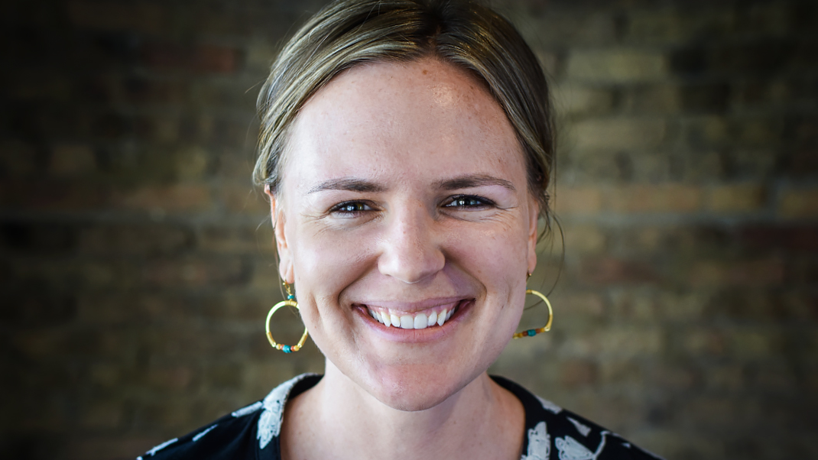
Liz Erickson
OFA Training Director
@LizzGErickson
Notes:
“We have people joining us from all across the country that are wanting to make a difference in their communities. Type in your city and state into the chat box, and give others some appreciation for being on the call!”

Slide 4
Alex Tornato
OFA Training Manager
@atornato

Slide 5
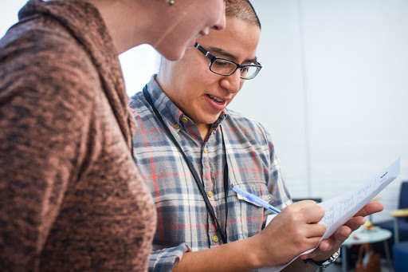
Leading with your values
The personal story

Slide 6
Tweet today using #OFAFellows

Slide 7
Week 1: Key takeaways

Slide 8
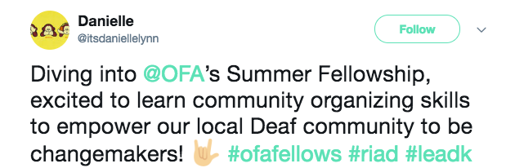
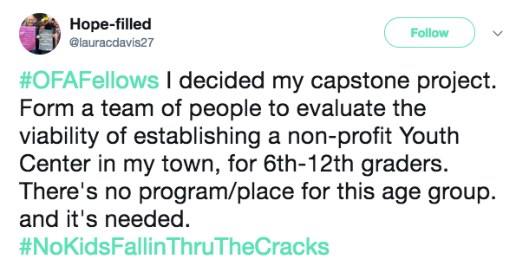
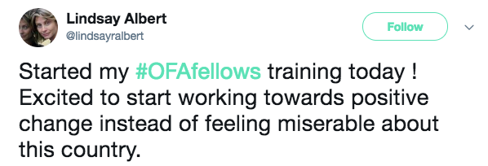
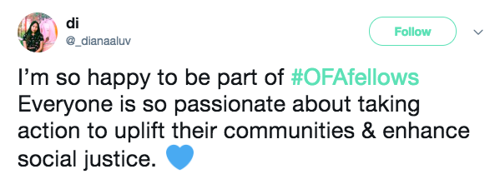
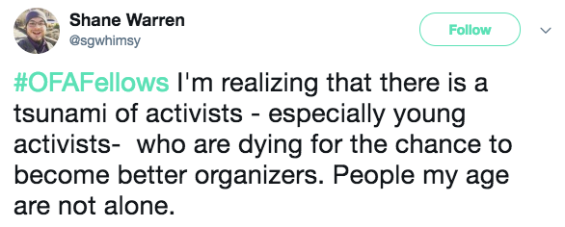
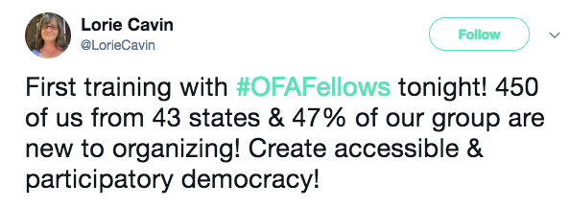
Notes:
Week 1 we talked through the important of 2018.
The people in office vote on the issues we care about – persuasive conversation means something different based on where you are and who you are talking about. Talking to people who are on the fence. You want folks to see how the issues feel and
We are thinking about our neighbors, the people we work with, family – we’re thinking about our social network. We are thinking about it differently than campaign work because we are thinking about organizing in the long-term.
Note--- this is a TYPE of personal story

Slide 9
Goals for
today
1
Analyze underlying reasons why engaging in persuasive conversations is difficult, both individually and interpersonally.
2
Apply the theory of ‘knowing your why’ to people you will talk to in your organizing work.
3
Examine applications of speaking from your why to building a team.
Notes:
Week 1 we talked through the important of 2018.
The people in office vote on the issues we care about – persuasive conversation means something different based on where you are and who you are talking about. Talking to people who are on the fence. You want folks to see how the issues feel and
We are thinking about our neighbors, the people we work with, family – we’re thinking about our social network. We are thinking about it differently than campaign work because we are thinking about organizing in the long-term.
Note--- this is a TYPE of personal story

Slide 10
Agenda
The incredible rarity of changing your mind
Theory building with Simon Sinek
Speaking from your 'why’
Building a team
Debrief & next steps
Notes:
7:10- 7:11 (1 MINUTE)
[LIZ]

Slide 11
Why is changing someone’s opinion so difficult?
FOLLOWING CLIP:
The Incredible Rarity of Changing Your Mind
from This American Life
Notes:
7:11- 7:13 (2 MINUTES)
[LIZ PASSES TO TRACI]
[ADRIENNE MONITORS THE CHAT BOX]
Hello everyone! So excited to have you on the call and hope you are learning a lot from this series, I know that I am!
So, in our work as organizers, we want to have conversations with people so we can get them to do something we want them to do. Whether convince a supporter to make phone calls, or an elected official to vote a certain way on a piece of legislation or whatever the scenario, but we aren’t always successful. As we learned in the last two weeks, we need to be good listeners and understand what motivates someone’s position.
We know from experience how challenging it is to change someone’s opinion, but we will break down why that is and how we can begin to craft strategies to be more effective in our conversations.
To get our minds going, we have a clip ahead from the podcast, “This American Life.” Listen to the following clip with this thought in mind.” As you listen to this, think about why it’s so difficult to change someone’s mind.
“Why is changing someone’s opinion so difficult?” We have all run into someone that we had trouble talking to and getting them to think about something that we really cared about.

Slide 12
Notes:
7:13- 7:15
[TRACI -- Press play on the left hand corner of the orange square]

Slide 13
BRAINSTORM:
Why is it difficult to persuade someone to change?
Type your thoughts into the chat box.
Notes:
7:15- 7:18 [3 minutes]
[TRACI facilitating; ADRIENNE will share what she is sharing and synthesizing what is written in the chat box]
So, as Ira Glass points out, it’s really difficult, why do you think that is?
why is it so difficult to persuade someone to change? Type your thoughts into the chat box and Adrienne will read out some of your responses.

Slide 14
Challenges to persuasion
Personal Anxiety
Notes:
7:18 [0 minutes]
[TRACI]
We have some beliefs about this and why it can be so difficult.
For example, personal anxiety. When we talk about opposing points of view, we are tapping into values and experiences that someone holds really deeply, and might be a source of anxiety.

Slide 15
Challenges to persuasion
Personal Anxiety
Interpersonal differences
Notes:
7:17- 7:18 [1 MINUTE]
[TRACI]
We all orient ourselves to the world differently based on our personal experiences. When conflicting values clash, because they are coming from different orientations, that makes it hard to find common ground.

Slide 16
Challenges to persuasion
Personal Anxiety
Interpersonal differences
Fractured political context
Notes:
7:18- 7:19 [1 MINUTE]
[TRACI]
Particularly around politics there can be some serious challenges to persuading someone to a point of view. It’s hard to have a conversation when we don’t have shared facts or sources because then we can’t find common ground, which leads to polarization and the entrenched positions we find ourselves in today.
Feel free to give in an example

Slide 17
Challenges to persuasion
Personal Anxiety
Interpersonal differences
Fractured political context
The “ask” typically associated
Notes:
7:18- 7:19 [1 MINUTE]
[TRACI]
Personally, I am always terrified by the ask – that’s it’s going to be something I really don’t want to do, like make phone calls. Just in general I don’t really like talking on the phone, especially to strangers, so the thought of making calls is stressful for me. But that is one of the “typical” asks, so – as a personal reflection – think about what you can do to help mitigate that kind of anxiety in your conversation.

Slide 18
Agenda
The incredible rarity of changing your mind
Theory building with Simon Sinek
Speaking from your 'why’
Building a team
Debrief & next steps
Notes:
7:10- 7:11 (1 MINUTE)
[LIZ]

Slide 19
We can cut through the clutter when we have conversations that speak to the head and the heart.
Notes:
7:19 – 7:20 [1 MINUTE]
[TRACI]
You don’t have to be an experienced policy maker and know all the ins and outs of a bill to discuss your “WHY” with your neighbor. We can cut through the clutter when we have conversations that speak to the head and the heart.

Slide 20
Notes:
7:20 – 7:23 [3 MINUTES]
[TRACI]
1:36- 4:36: Theory of why, how, what and quick example of apple from author and marketing consultant, Simon Sinek It’s about 3 minutes long.

Slide 21
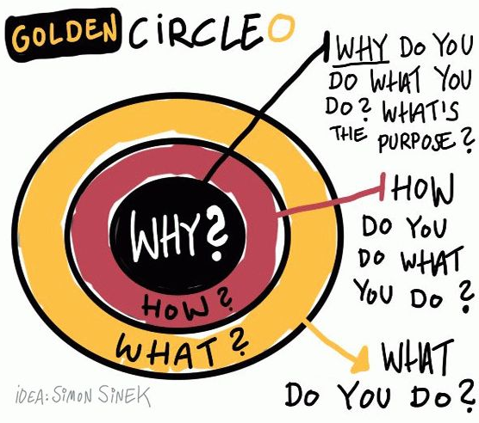
Notes:
7:23- 7:26 [3 minutes]
[TRACI]
Discussion of WHY, HOW, WHAT
What we to convey is that if you start with your belief and communicate your WHY, it will resonate with people in the way a WHAT never can. So, the order is important here as well – you need to start with your WHY in order to be able to start to build a connection based on shared values, then move outward.
Because the WHY is what moves YOU – it is the core thing that makes you tick. It is your reason to get out of bed. It’s the thing that you might have subconsciously operated with but not likely articulated out loud
HOW: ‘How’ is your theory of change – it is the way that you believe your why can come into the world
WHAT: ‘What’ is the thing that you are now doing as a result of your how – it is your specific actions associated with your theory of change.
In politics, we frequently start with WHAT which is not how you can easily connect with people – it tends to be superficial and can feel inauthentic.
If we take this model presented by Simon, then you can see how it shakes out with organizations as well. Here’s a couple of examples to compare and contrast.

Slide 22
How can we apply these reflections to community organizing?
Notes:
7:30-7:33 [3 MINUTES]
[TRACI SYNTHESIZES]
Distinguish between personal story and your ‘why’: they serve different purposes!
When you know your why, it enables you to reflect on your values and connect with your neighbors to spark a different conversations
We don’t assume that every conversation we have will end with an ‘ask’

Slide 23
You have to understand your why and be genuinely curious about your neighbor’s why.
Notes:
So now we are going to use this framework to understand our why and do a few exercises to apply what we’ve talked about.

Slide 24
Agenda
The incredible rarity of changing your mind
Theory building with Simon Sinek
Speaking from your 'why’
Building a team
Debrief & next steps
Notes:
7:10- 7:11 (1 MINUTE)
[LIZ]

Slide 25
One method to identify your ‘why’
Critical incidents:
Critical incidents are events in your life that you can recall being an important moment for you in clarifying what you believe.
-Stephen Brookfield

Slide 26
One method to identify your ‘why’
Critical incident question:
When was the first time you remember standing up for something that you believed in?
Notes:
7:43 – 7: 45 [2 minutes]
Reference pre-work – you can share here if you are willing

Slide 27
Here’s an example
Notes:
Facilitator shares their critical incident

Slide 28
Narrowing in on our critical incidents help to clarify our values and beliefs

Slide 29
WHOLE GROUP CHATBOX
From the critical incident
story you heard, what values do you hear from the story?
Notes:
7:53- 7:57 [4 minutes]
Group shares underlying values- types in chat box and people press one to share

Slide 30
Now it’s
your turn
Remember: Having a clear, concise why keeps us connected to why we do what we do, helps us connect to others, and when shared, has the opportunity to build trust and community.
Type in the chat box to share your critical incident and tweet using #OFAFellows
Notes:
7:47- 7:53 [6 minutes]
It’s ok if that takes a second – this is hard! Really think about the FIRST time that happened because that was when you likely solified your belief around a particular value.
This is hard and takes a lot of practice, so some
This is very personal, so if you feel comfortable sharing, we would love to thear

Slide 31
WHOLE GROUP CHATBOX
In your own critical incident story, what values do you see?
Notes:
7:53- 7:57 [4 minutes]
ADRIENNE
Group shares underlying values- types in chat box and people press one to share
[TRACI pulls out some from the chat box and reads out loud]

Slide 32
Putting it all together:
The framework of your why
Critical incident
What is a critical incident that leads to what you believe and why?
Notes:
ADRIENNE

Slide 33
Putting it all together:
The framework of your why
Critical incident
What is a critical incident that leads to what you believe and why?
Values
What values are present underneath your critical incident and why?
Notes:
ADRIENNE

Slide 34
Putting it all together:
The framework of your why
Critical incident
What is a critical incident that leads to what you believe and why?
Values
What values are present underneath your critical incident and why?
Practice
How will you practice communicating your values in way that resonates with diverse groups of people?
Notes:
ADRIENNE

Slide 35
What changes will you make in conversations if you are trying to identify someone else’s why?
Notes:
7:XX- 7:XX [1 minute]
ADRIENNE
What changes will you make in conversations if you are trying to identify someone’s why?

Slide 36
Agenda
The incredible rarity of changing your mind
Theory building with Simon Sinek
Speaking from your 'why’
Building a team
Debrief & next steps
Notes:
Connect from why to building a team

Slide 37
SHOUT OUT
What is effective leadership?
Notes:
What does effective leadership look like to you? Let’s start building a list of good leadership characteristics.

Slide 38
Let’s look at an example

Slide 39
You’re conducting an orchestra

Slide 40
You’re conducting an orchestra
What organizational structures make it successful?
Notes:
A central conductor. Different sections for each instrument type; i.e. percussion, stringed instruments, singers, pianist. Each section has a “principal lead” who is the representative and lead player for the section.

Slide 41
You’re conducting an orchestra
Who is the central leader?
Are there any other leadership roles?
Notes:
A central conductor. Different sections for each instrument type; i.e. percussion, stringed instruments, singers, pianist. Each section has a “principal lead” who is the representative and lead player for the section.

Slide 42
An orchestra follows
a ”snowflake model” of leadership
Notes:
It is a hiearchical structure that empowers each layer to have leadership roles and a team through which to be sucessful.

Slide 43
We’ll dive more into this
model, but let’s look at
some others first…
Notes:
What does effective leadership look like to you? Let’s start building a list of good leadership characteristics.

Slide 44
MODELS OF LEADERSHIP
The Magnet Model
Notes:
We are going to examine three different leadership styles through the lens of our dinner party. The first style of leadership is the wagon wheel.

Slide 45
You
Notes:
Here you are

Slide 46
You

Slide 47
The Magnet
Model
1
Everyone is going to one person who cannot possibly handle all their questions and needs.
2
Not sustainable—one person gets overwhelmed.
3
Not empowering—one person holds all the knowledge.

Slide 48
Where do you see this model being effective?

Slide 49
Why doesn’t it work for organizing?

Slide 50
MODELS OF LEADERSHIP
The Anarchy Model
Notes:
We are going to examine three different leadership styles through the lens of our dinner party. The first style of leadership is the wagon wheel.

Slide 51
You

Slide 52
You

Slide 53
The Anarchy
Model
1
Everyone is going their own way.
2
There is no leadership structure.
3
Not working together to accomplish a goal.

Slide 54
MODELS OF LEADERSHIP
The Snowflake

Slide 55
You

Slide 56
You

Slide 57
The Snowflake
Model
1
Structured to empower leadership and delegation of responsibilities.
2
Clear lines of communication and coordination.
3
Working in harmony to accomplish a unifying goal.
Notes:
That’s great! You all have a lot of ideas as to what can happen if you appoint captains to help make your dinner party a success. Here are some ideas, some of which we already covered:
There are clear lines of communication— you are communicating with your captains and getting updates from them. Your captains are making sure their helpers are doing what needs to be done to make your party a success.
There are sustainable ratios—your only have to direct a few people and your captains only have to direct a few people.
The structure can handle change without overwhelming one person. If one of the helpers can no longer attend your dinner party, the captain can make sure that someone else covers for that person. The structure can handle change without overwhelming one person.
It empowers others—people want to help you out! Let them help, but don’t let them overwhelm you by using the snowflake structure.
We call this the Snowflake Model of leadership and this is what OFA uses to organize.
[discussion question] How do you see this being used in the organizing world?

Slide 58
Vol
The snowflake structure
The snowflake model relies on a lead organizer to function properly.
Vol
Org
Vol
Vol
Notes:
What functions do you think a chapter leader plays?

Slide 59
Vol
Lead organizer
Committed volunteer or staffer who takes responsibility for training and managing other volunteers and oversees the execution of grassroots organizing events.
Vol
Org
Vol
Vol
Notes:
What functions do you think a chapter leader plays?

Slide 60
Vol
Volunteer member
Trained and committed volunteer who own specific leadership roles, which are based on needs and vary from project to project.
Vol
Org
Vol
Vol
Notes:
What functions do you think chapter member play?
Snowflake chapter members own specific leadership responsibilities and report to the snowflake chapter leader
The roles and responsibilities of chapter members will vary by issue and by turf
What are examples of chapter member roles you can think of?
Press captain
Volunteer manager
Outreach captain

Slide 61
“We’re approaching leadership as a practice, not leadership as a position…It’s about accepting responsibility for enabling others to achieve purpose under conditions of uncertainty.” - Marshall Ganz

Slide 62
Where else have you seen the snowflake model used to accomplish big goals?

Slide 63
Agenda
The incredible rarity of changing your mind
Theory building with Simon Sinek
Speaking from your 'why’
Building a team
Debrief & next steps
Notes:
7:10- 7:11 (1 MINUTE)
[LIZ]

Slide 64
Debrief
In what situations do you think you’ll most easily share your why?
In what situations do you think it will be more difficult to share your why vulnerably?
Notes:
Eye on a bigger prize – connect it to issues you care about – your vision in the future
Some places you’ll likely share your why/personal story
Sharing their story at their representatives office and it going public in a digital way
Humble and small -- at the dinner table or at the door with a voter; brother or roommate
Change and adapt to fit those conditions

Slide 65
What are your key takeaways?
Type in the chat and tweet using #OFAFellows

Slide 66
Weekly assignment:
Due Wednesday, August 1
https://www.ofa.us/get-trained/fellows-resources/
1
How and when will you be engaging the community?
What people do we need at the table? When will you reach out to them?
Which groups, organizations, community members will you focus on?
What are your next steps?
2
3
4

Slide 67
Thanks for joining the call!
Please fill out the evaluation on today’s training using the link below.
bit.ly/Summer2-2018
Email fellows@ofa.us with any questions.

Slide 68
Thank you!
Notes:
1 MINUTE
TRACI + ADRIENNE
OFA -- TRACI
1) December 7: Redistricting call with NDRC
2) MLK DAY OF SERVICE = VR: Email organizing@ofa.us if you would like to get involved with voter registration
3) JOIN THE NEXT CALL
Link to put in chat box: https://zoom.us/webinar/register/WN_tUkjIhBnTGSSGPhQ1MQgaQ

