Slide 1
Phone Banking for Success
Name, role
@twitter handle
Notes:
This work is licensed under the Creative Commons Attribution-NonCommercial 4.0 International License. To view a copy of this license, visit http://creativecommons.org/licenses/by-nc/4.0/ or send a letter to Creative Commons, PO Box 1866, Mountain View, CA 94042, USA

Slide 2
Goals for this session
Understand why phone calls and phone banking is so important to organizers
Practice the components of a successful phone call
Feel confident about making phone calls
Notes:
During this session, we are going to discuss the #1 tool we use as organizers—phone calls! We’re going to get lots of practice with making calls during this session, but first let’s review our goals:
Understanding why making phone calls and phone banking is so important to organizers
Practice each component of a successful phone call
Leave this module feeling confident about making phone calls as part of a progressive organization

Slide 3
Agenda for this session
Goals and Agenda
Phone Banking 101
Hands On Practice
Debrief and Close
Notes:
Now that we know our goals for the session, let’s go over the agenda that will guide us to achieving them.
We’re finishing up the goals and agenda section now
Then we’ll move on to phone banking 101
Next we’ll learn what a hard ask is and why it’s important
Then comes time for us to put it all together and practice what we learned in the previous sections
Last, you’ll report back on your experience and debrief your experience. So let’s get started!

Slide 4
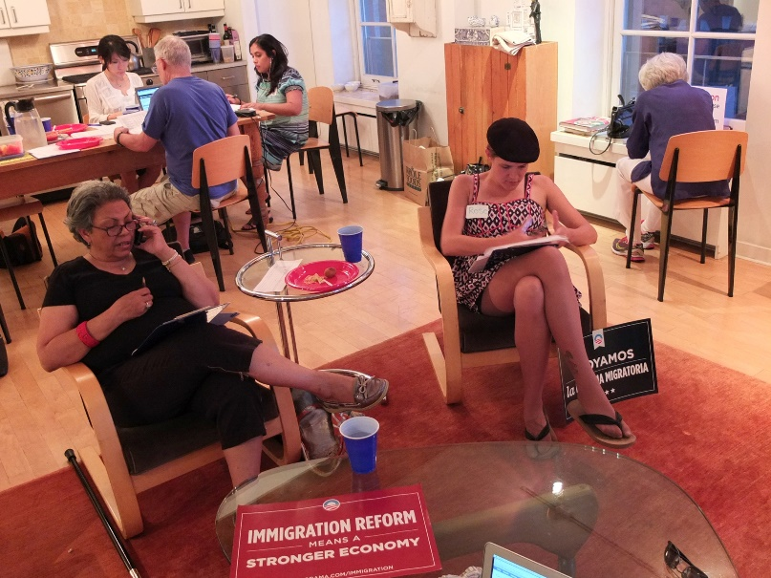
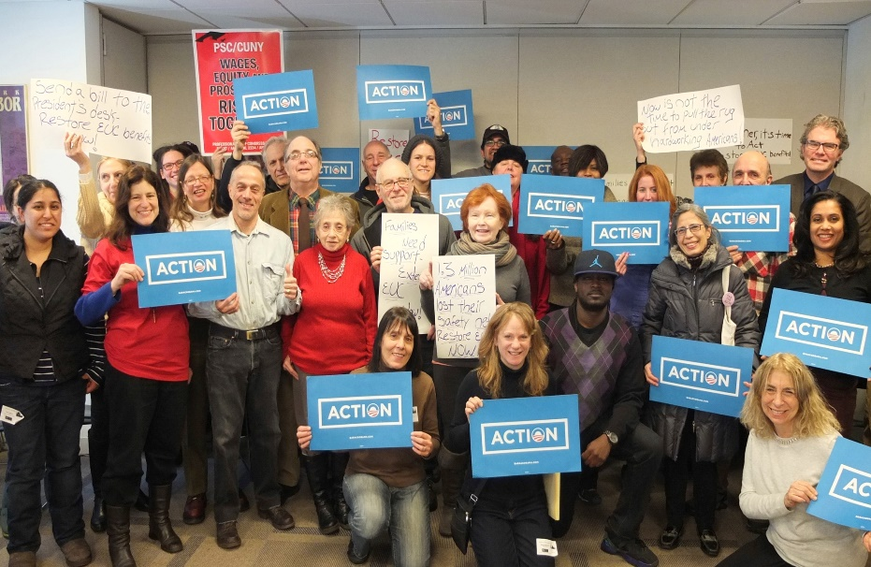
Why we make phone calls
Notes:
Let’s start off this section with a popcorn-style discussion about why we make phone calls as organizers.
These are all great reasons! The reasons we came up with are:
Nothing beats hearing a real person’s voice on the other end of the phone when making a volunteer ask, confirming someone for an upcoming shift, or asking them to take action in some other way.
Phone banks are the most efficient way to community with a large group of people in a short amount of time
A friendly voice on the phone can go a long way to educate others on issues and be a source of information
Phone banks help build teams and the progressive movement
[animation cue] phone banks turn prospective volunteers into active ones because they were asked to do something! Just a few people making phone calls during a phone bank can turn out exponentially more people for an event.
Before we move on, take out your sample organizer schedule and see how much time each day is spent on the phone. Organizers participate in call time every night to recruit new volunteers and build for events. Making effective phone calls is the most important skill an organizer has.

Slide 5
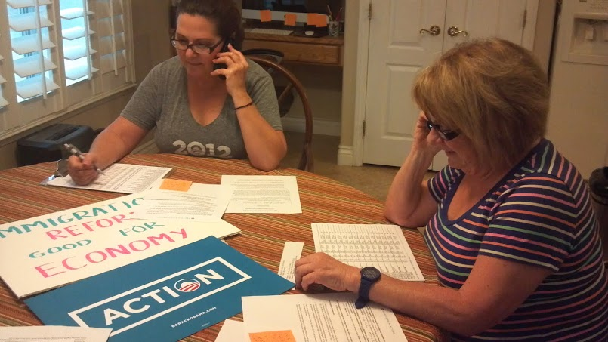
What to expect when phone banking
A 10%-20% contact rate is normal
Calls are made to a specific universe– no cold calling
Not every call will be positive, and that’s okay
Notes:
So while a phone bank does all these incredible things for organizers and organizations, there are certain realities of phone banks to keep in mind:
The first is that we’re only going to talk to 10%-20% of the people we call. Many people aren’t home, or have moved, or the phone number we have on file no longer works. All the data we collect while making phone calls helps us clean up our data. For example, if someone moves out of state, we can remove them from our list because they won’t be attending any of our events.
The second point is that we make calls into a specific universe of people—we want to be as targeted as possible when making phone calls. Cold calling is inefficient and ineffective for building our movement. The system used varies by organization, but your call list will never be generated by the phone book!
Not every call will generate a volunteer, and that’s okay! If someone can’t volunteer or tells you “no”, don’t take it personally. Politely thank them for their time and then move on to the person—other people can’t wait to hear from you!

Slide 6
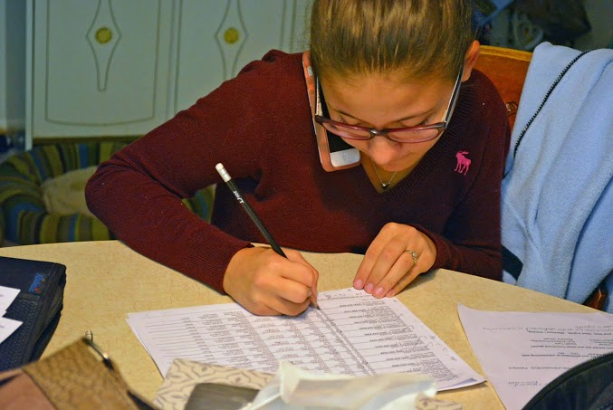
Phone Banking Best Practices
Call between 5:00pm and 9:00pm
Practice the script
Be casual and relaxed
on the phone
Make a hard ask
Notes:
There are few best practices for making phone calls that lead to more success on the phones.
First, the time of day you make calls is important. The best time to call is between 5:00pm and 9:00pm as that’s when most people are home and available to answer the phone.
Practice the script before you start making calls. It’s important to know what you’re calling about before you start dialing but it’s also important to make the script something you’re comfortable saying, which leads to our next point.
Be casual and authentic on the phone—no need to read the script word for word or sound like a robot! Be genuine and the folks on the other end of the phone will respond positively.
Make a hard ask.

Slide 7
Agenda for this session
Goals and Agenda
Phone Banking 101
Hands On Practice
Debrief and Close
Notes:
Now that we know how to phone bank and how to make hard asks, it’s time to put it all together and actually phone bank!

Slide 8
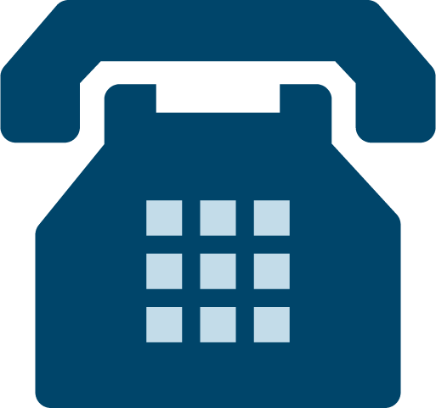
Pair Up and Practice!
Notes:
[slide 8] [hand out calls lists and scripts and discuss answer codes]
Remember one of the phone banking best practices is to practice your script before you start making calls. So, find a partner and practice your script with one another. You’ll have 2 minutes each to practice.
Now that you have had time to practice your script, it’s time to get calling! [Explain the logistics of the phone bank (time to be spent phone banking, answer codes, etc.)]

Slide 9
Start Dialing!
The ask your phone bankers are making
Date and time
Location

Slide 10
Agenda for this session
Goals and Agenda
Phone Banking 101
Hands On Practice
Debrief and Close
Notes:
Now that you’ve had some time to practice, let’s debrief!

Slide 11
Debrief
What surprised you about making phone calls?
What do we gain from phone banking?
How do we get others to join us?
Notes:
What surprised you about making phone calls?
What do we gain from phone banking?
How do we get others to join us?

Slide 12
Goals for this session
Understand why phone calls and phone banking is so important to organizers
Practice the components of a successful phone call
Feel confident about making phone calls
Notes:
Let’s review our goals for this session and take a temperature reading for how we did! (thumbs up, down, to the side)
Do you understand why we make phone calls and why phone banking is so important to organizers?
How do you feel about phone banking coming out of our practice time?
Do you feel confident making phone calls as an organizer?

Slide 13
Questions?

